Slide 1

CS3004D Software Engineering
SDLC – Software Development Life Cycle

Slide 2
Summary
Need an engineering approach
Software development life cycle
Problem definition
Feasibility Study

Slide 3
Software Development Life Cycle
Problem Definition
Feasibility Study
Requirements Analysis
Design
Implementation
Testing
Maintenance
Retirement

Slide 4
Requirements Analysis
Knowing user’s requirement in detail
Objective is to determine what he system must do to solve the problem (without describing how)
Produces SRS document
Incorrect, incomplete, inconsistent, ambiguous SRS often results in project failure

Slide 5
Requirement Analysis
Challenging
Users may not know exactly what is needed
Users may change their mind over time
Users may have conflicting demands
Users may not be capable to differentiate between what is possible and what is impractical
Analyst has no or limited domain knowledge
Client may be different from the user

Slide 6
SRS
First and most important baseline
What the system will be able to do
Basis for validation and final acceptance
Cost increases rapidly after this step
Should be reviewed in detail by user and other analyst
Should be adequately detailed
It identifies all functional and performance requirements

Slide 7
Requirements Analysis Process
Interviewing clients
Studying existing things
Long process – should be organized systematically
Identifies users and business entities
Get functional or domain knowledge
Often goes outside – in

Slide 8
Organizing Findings
Massive amount of information through study
Need to be organized, recorded and classified
Ensure consistency and completeness
Prepare SRS
Get it reviewed

Slide 9
Design
Deals with “ How “
Consider several technical alternatives
Input is the SRS
Prepare for technical management review
Finally delivers design document

Slide 10
Design Goals
Processing component
Data component
Different design paradigms
System structure
Decomposes the complex system
Defines the subsystems or modules

Slide 11
Implementation
Coding are done
Translating design specification into the source code
Source code along with internal documentation
To reduce the cost of later phases
Making the program more readable
General coding standards
Notes:
The coding is the process of transforming the design of a system into a computer language format. This coding phase of software development is concerned with software translating design specification into the source code. It is necessary to write source code & internal documentation so that conformance of the code to its specification can be easily verified.
Coding is done by the coder or programmers who are independent people than the designer. The goal is not to reduce the effort and cost of the coding phase, but to cut to the cost of a later stage. The cost of testing and maintenance can be significantly reduced with efficient coding.
Goals of Coding
To translate the design of system into a computer language format: The coding is the process of transforming the design of a system into a computer language format, which can be executed by a computer and that perform tasks as specified by the design of operation during the design phase.
To reduce the cost of later phases: The cost of testing and maintenance can be significantly reduced with efficient coding.
Making the program more readable: Program should be easy to read and understand. It increases code understanding having readability and understandability as a clear objective of the coding activity can itself help in producing more maintainable software.
Indentation: Proper and consistent indentation is essential in producing easy to read and maintainable programs. Indentation should be used to:
Emphasize the body of a control structure such as a loop or a select statement.
Emphasize the body of a conditional statement
Emphasize a new scope block
Inline comments: Inline comments analyze the functioning of the subroutine, or key aspects of the algorithm shall be frequently used.
Rules for limiting the use of global: These rules file what types of data can be declared global and what cannot.
Structured Programming: Structured (or Modular) Programming methods shall be used. "GOTO" statements shall not be used as they lead to "spaghetti" code, which is hard to read and maintain, except as outlined line in the FORTRAN Standards and Guidelines.
Naming conventions for global variables, local variables, and constant identifiers: A possible naming convention can be that global variable names always begin with a capital letter, local variable names are made of small letters, and constant names are always capital letters.
Error return conventions and exception handling system: Different functions in a program report the way error conditions are handled should be standard within an organization. For example, different tasks while encountering an error condition should either return a 0 or 1 consistently.

Slide 12
Testing
Testing is important because software bugs could be expensive or even dangerous.
Process of evaluating whether the current software product meets the requirements or not.
Checks for missing requirements, bugs or errors, security, reliability and performance
Notes:
Software Testing is Important because if there are any bugs or errors in the software, it can be identified early and can be solved before delivery of the software product. Properly tested software product ensures reliability, security and high performance which further results in time saving, cost effectiveness and customer satisfaction
process of evaluating a software product to find whether the current software product meets the required conditions or not. The testing process involves evaluating the features of the software product for requirements in terms of any missing requirements, bugs or errors, security, reliability and performance
Typically Testing is classified into three categories.
Functional Testing
Non-Functional Testing or Performance Testing
Maintenance (Regression and Maintenance)
Software testing involves the execution of a software component or system component to evaluate one or more properties of interest. In general, these properties indicate the extent to which the component or system under test:
meets the requirements that guided its design and development,
responds correctly to all kinds of inputs,
performs its functions within an acceptable time,
is sufficiently usable,
can be installed and run in its intended environments, and
achieves the general result its stakeholders desire.
As the number of possible tests for even simple software components is practically infinite, all software testing uses some strategy to select tests that are feasible for the available time and resources. As a result, software testing typically (but not exclusively) attempts to execute a program or application with the intent of finding software bugs (errors or other defects). The job of testing is an iterative process as when one bug is fixed, it can illuminate other, deeper bugs, or can even create new ones.
Software testing can provide objective, independent information about the quality of software and risk of its failure to users or sponsors.^{[1]}
Software testing can be conducted as soon as executable software (even if partially complete) exists. The overall approach to software development often determines when and how testing is conducted. For example, in a phased process, most testing occurs after system requirements have been defined and then implemented in testable programs. In contrast, under an agile approach, requirements, programming, and testing are often done concurrently

Slide 13
Maintenance
Goal is to modify and update software after delivery
Correcting errors
Improving performance or capabilities
Deletion of obsolete features
Optimization
Types of Software Maintenance
Corrective
Adaptive
Preventive
Perfective

Slide 14
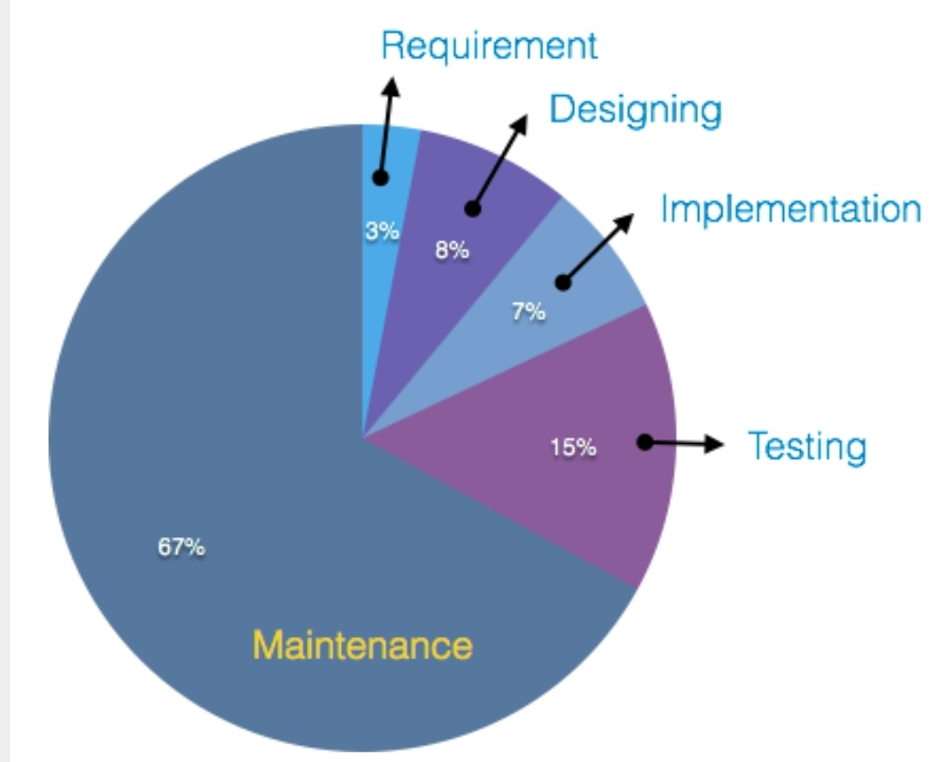
Cost Comparison over Phases

Slide 15
Software Retirement Process
Application Decommission or Application sunsetting
Final stage of life cycle
Shutting down
Reasons
Replaced
Release no longer supported
Redundant
Obsolete

Slide 16
Thank You

